Slide 1
USF class projects
Geospatial Analysis using R
Fall 2021

Slide 2
Student Projects
Surveillance: Detroit and Baltimore
BudgetFlow: San Francisco
Policeprop: San Francisco
Hashtag sweep: Continental US
Pilii comments in red.

Slide 3
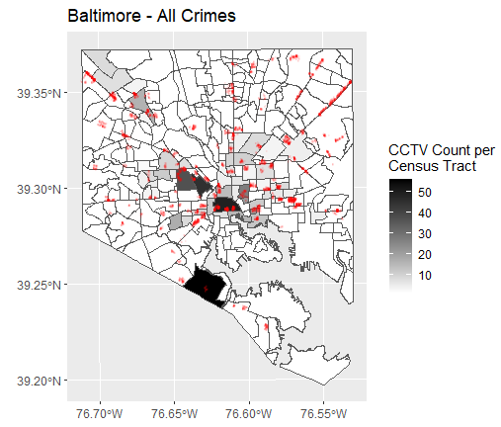
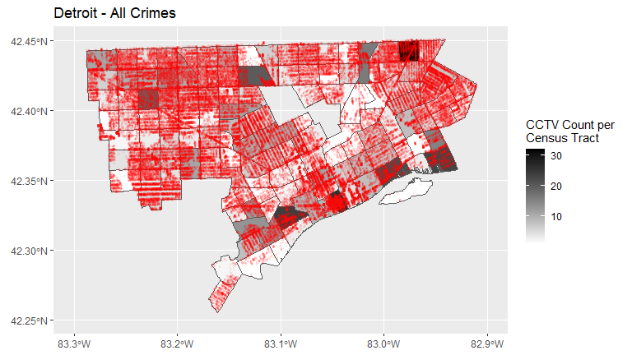
SURVEILLANCE (Arman, Aiyin, Claire)
Interested in the correlation between surveillance and socioeconomic variables, such as local crime rate, income, and the composition of population.
The analysis of surveillance across Detroit, MI, and Baltimore, MD are based on the distribution and relationships of cctv and crime, income, and minority population.
Crime: Arson, Assault, Homicide, Larceny, Robbery, Stolen vehicles.
Outlier spotted (cctv density) Mohican Regent. Part of 48205 ZIP code “The Red Zone”.
Outlier spotted (cctv density)
Cherry Hill, Largest public housing project in the city
Future research question: What is happening in the other high-density (cctv) tracts?

Slide 4
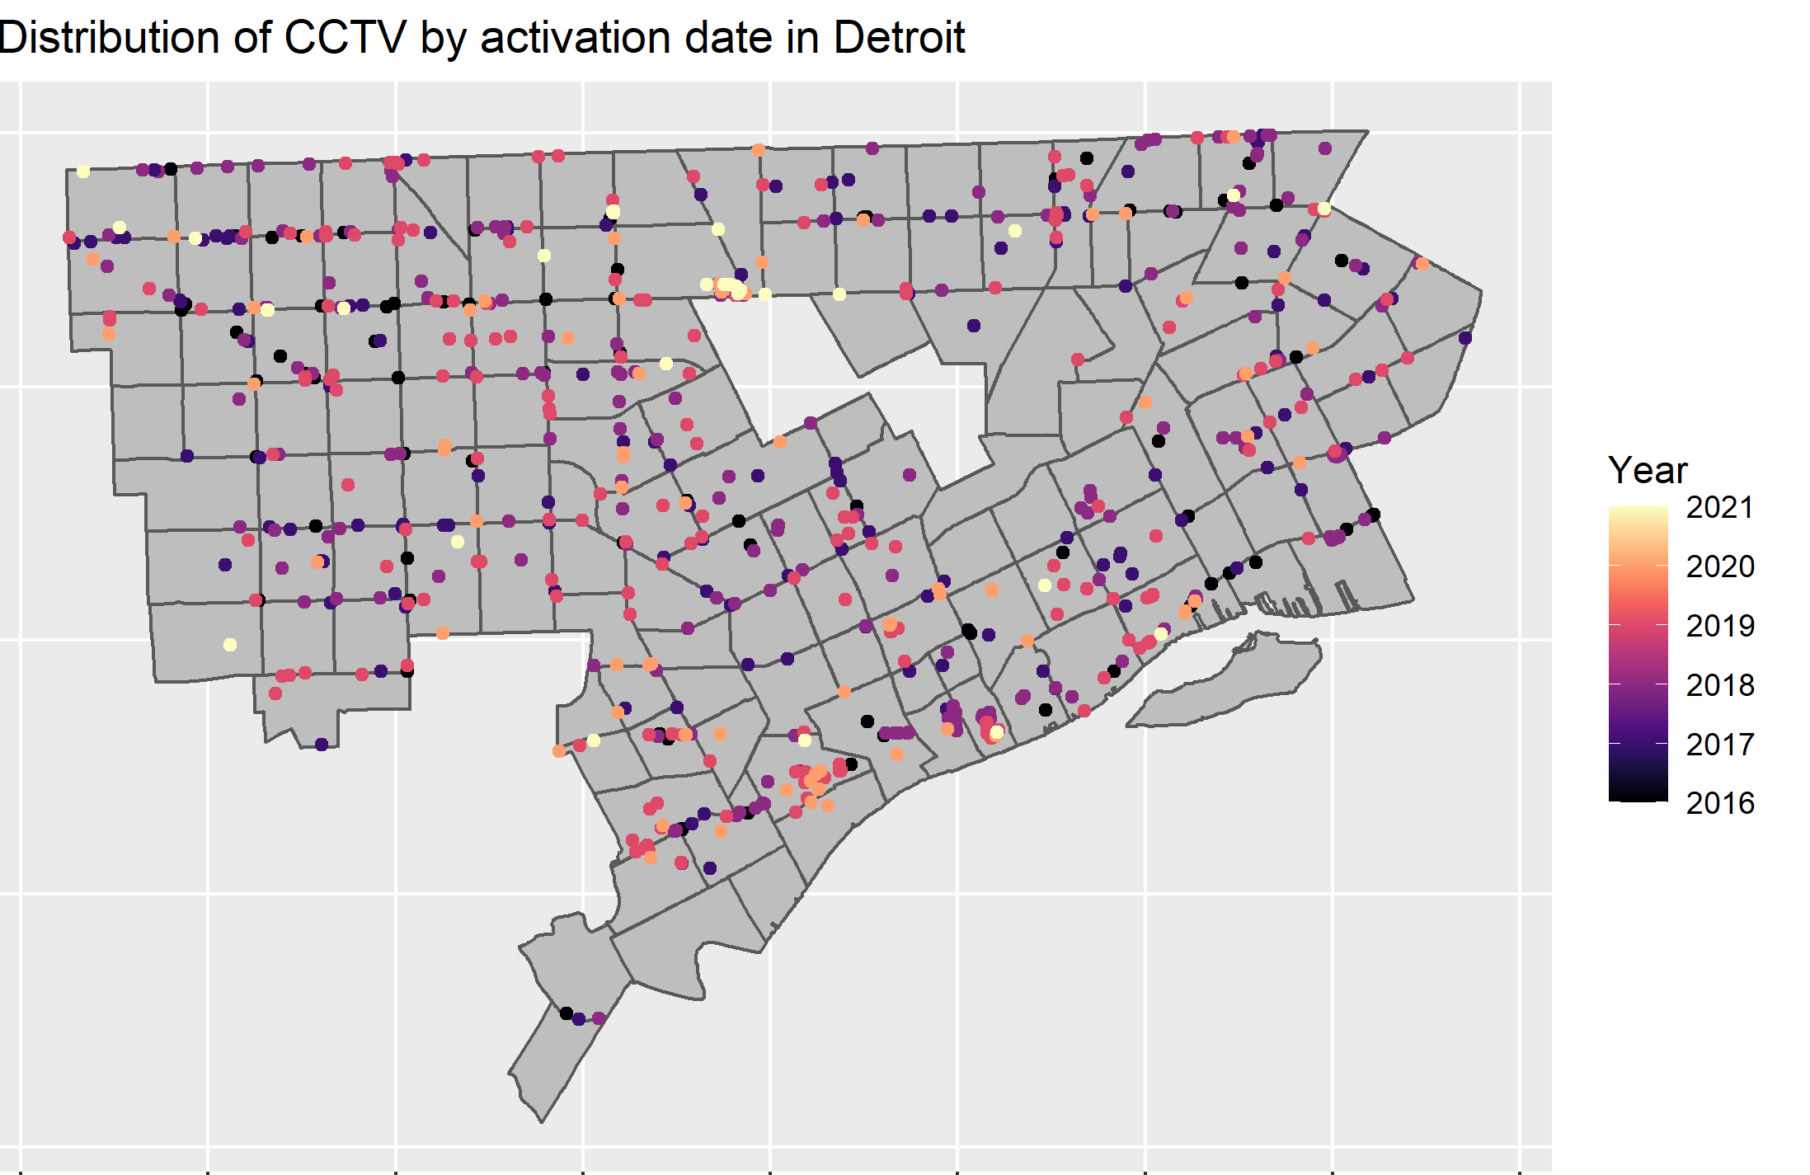
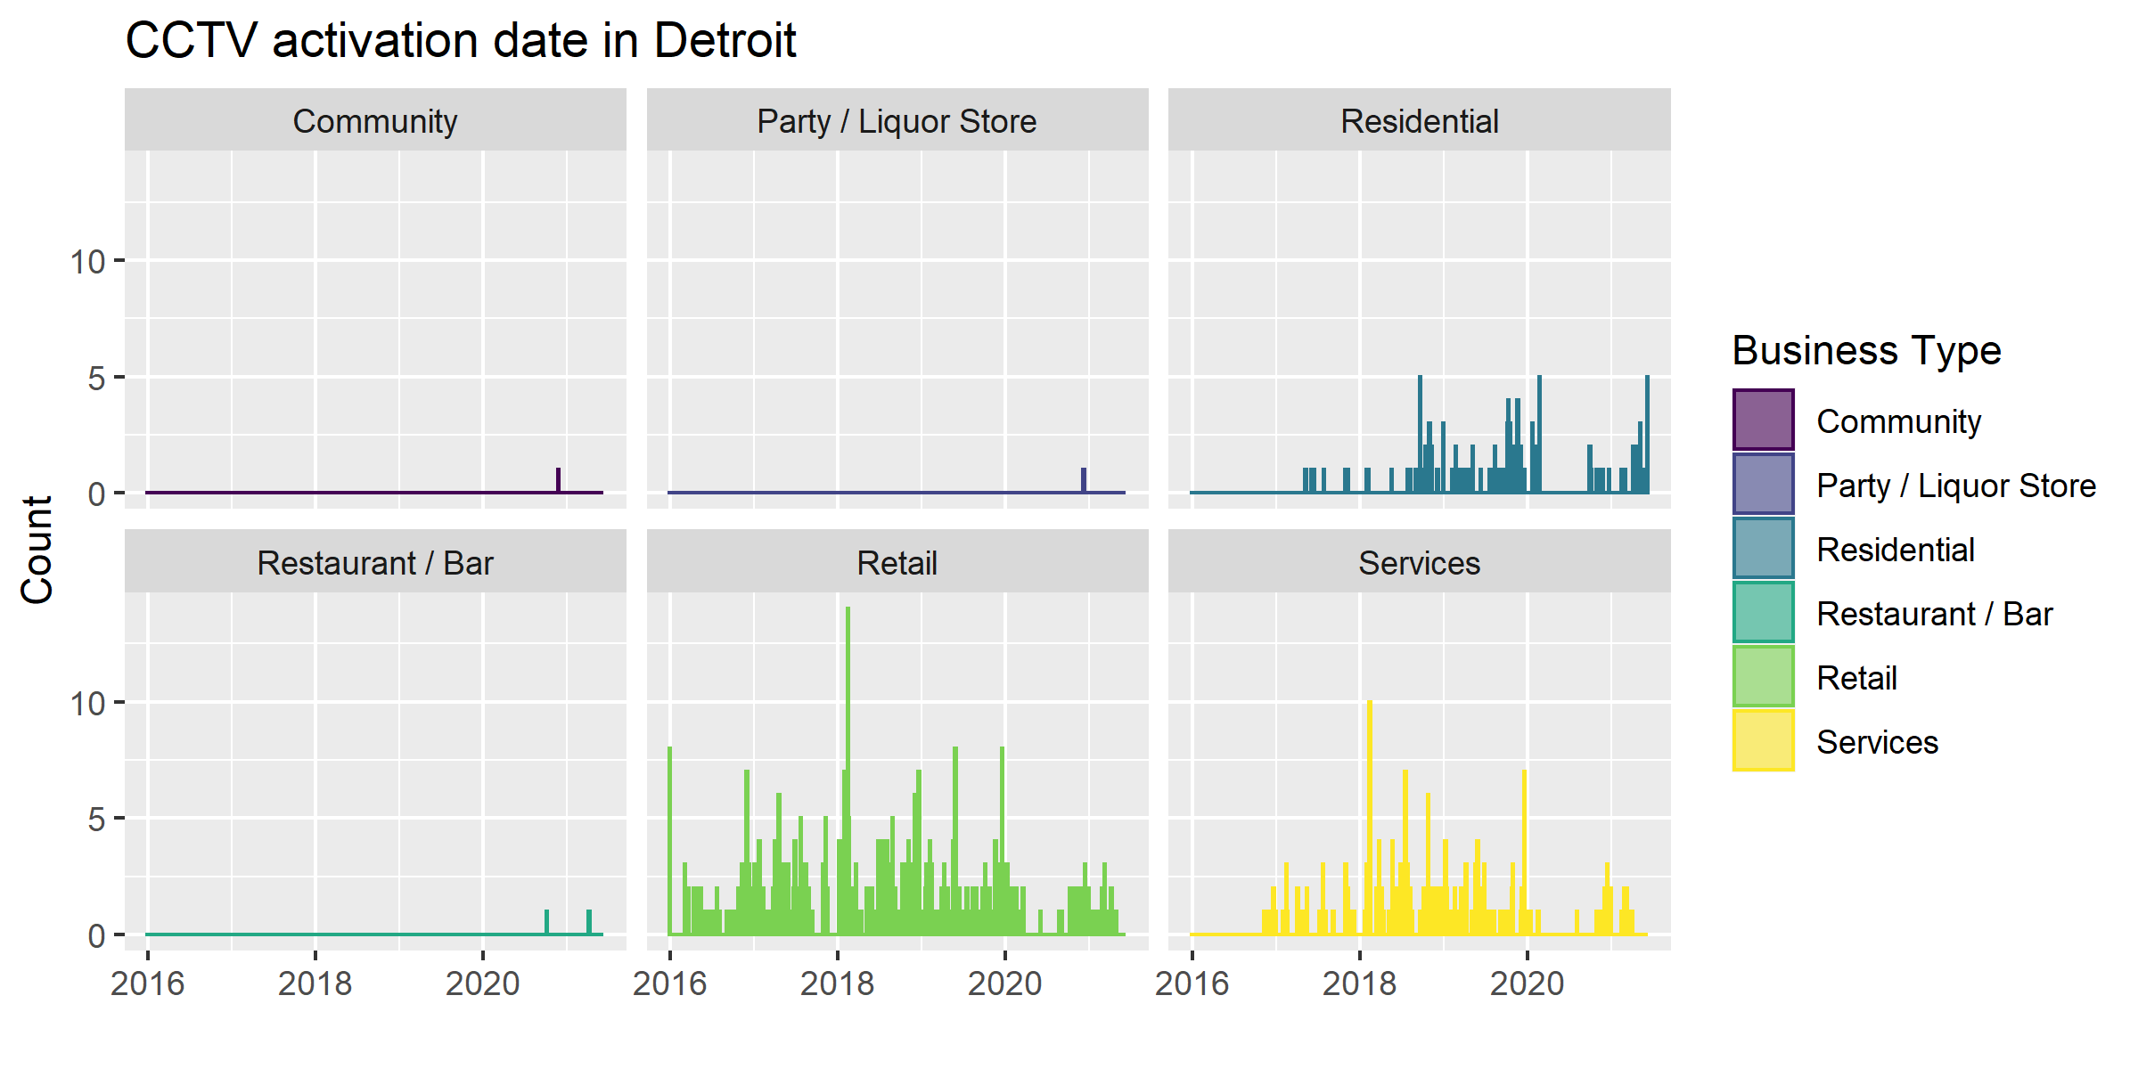
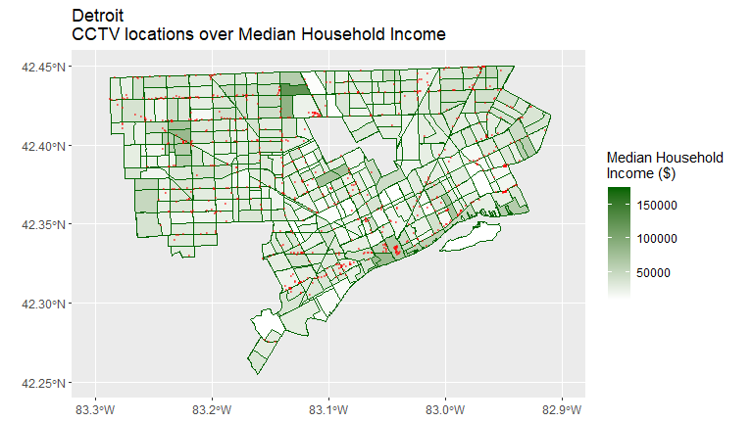
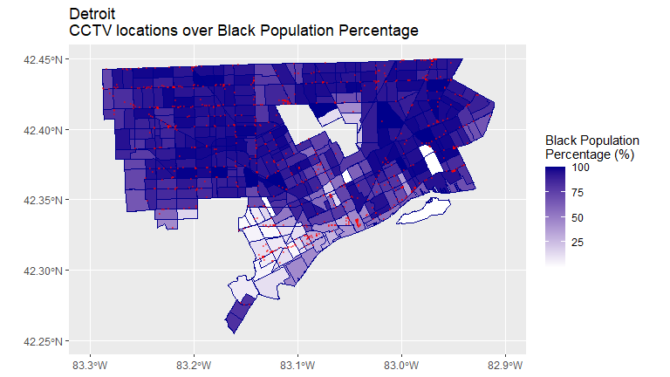
How do these dates overlap with “rising crime” reports/narratives/etc.?
Add zoning or land-use overlay
Perhaps map distribution/density of business type surveillance by tract or income?

Slide 5
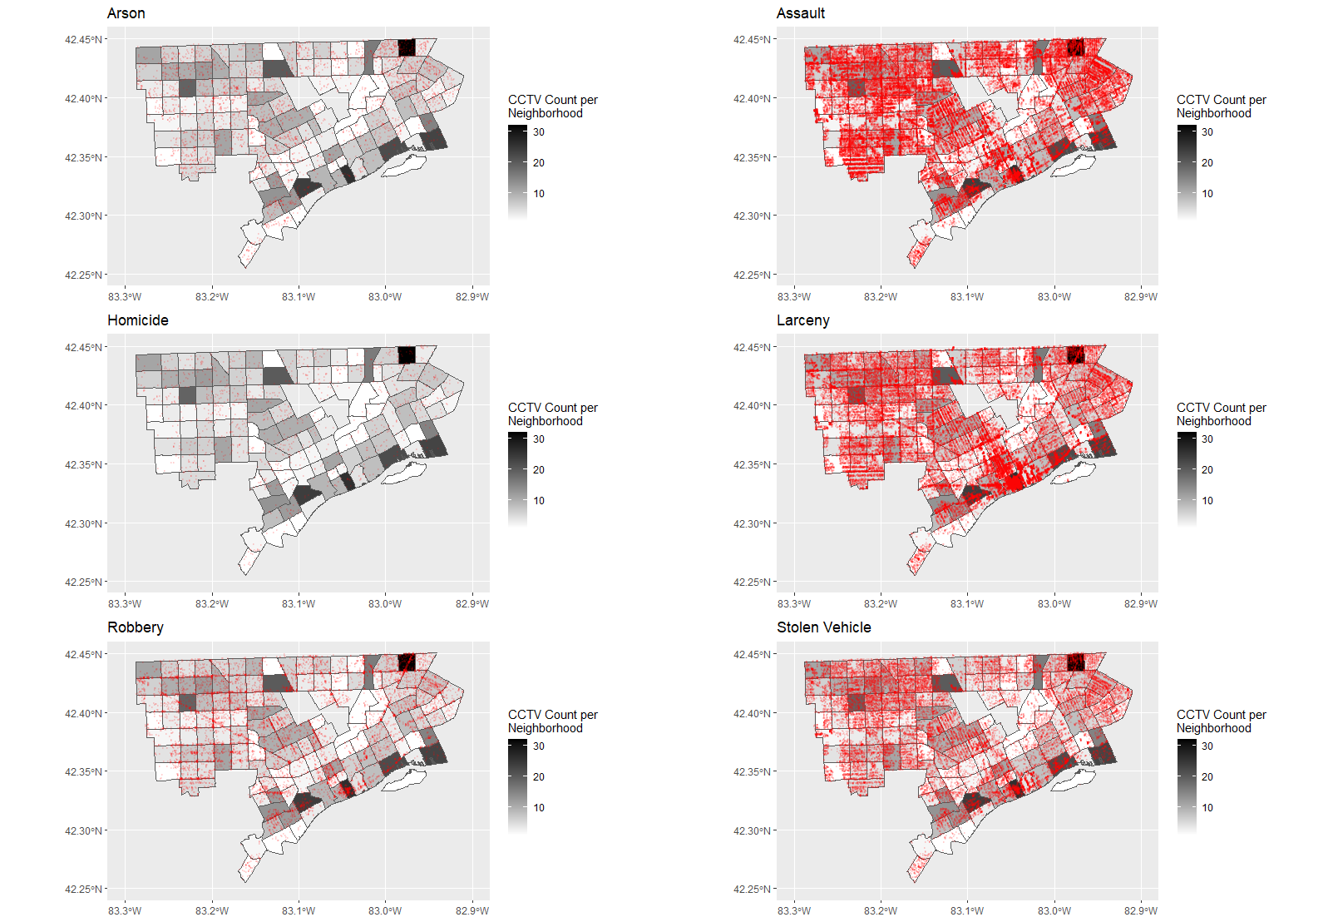
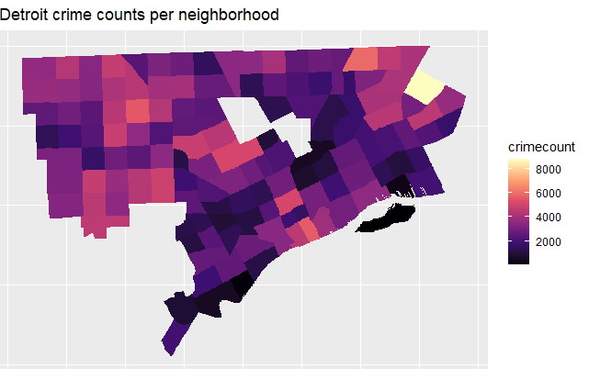
No clear pattern in terms of categories of crime, maybe something comes up if we add temporal factor.
Outlier spotted: Denby, Yorkshire Woods, Moross-Morang neighborhoods. Next step: Look at property values/zoning.
Outlier spotted: Delray. Next step: Look at numbers, property values/zoning, policing.

Slide 6
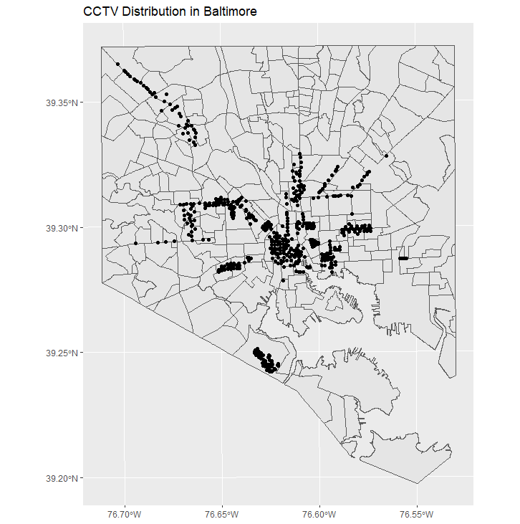
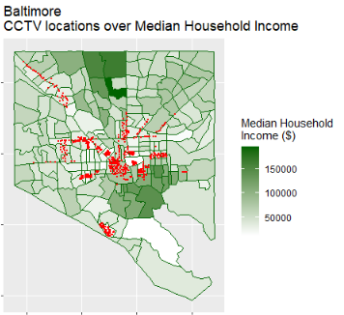
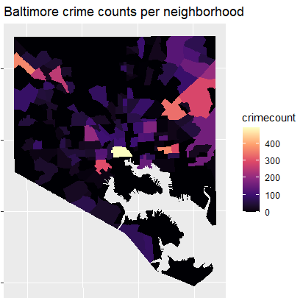
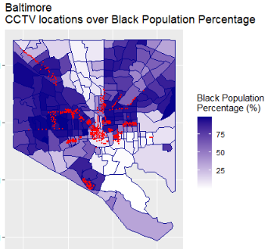
Unlike Detroit, we don’t have dates of when these went online.
The contrast between some neighborhoods and others is striking. Is it underreporting? Overreporting? Police presence? Next step: Overlay with strategic policing areas.
These maps confirm what we already know. I would add more information, zoning, parcel values, another explanatory variable. Except, Baltimore city doesn’t share information. We could purchase it if needed or reach out to the city for data.

Slide 7
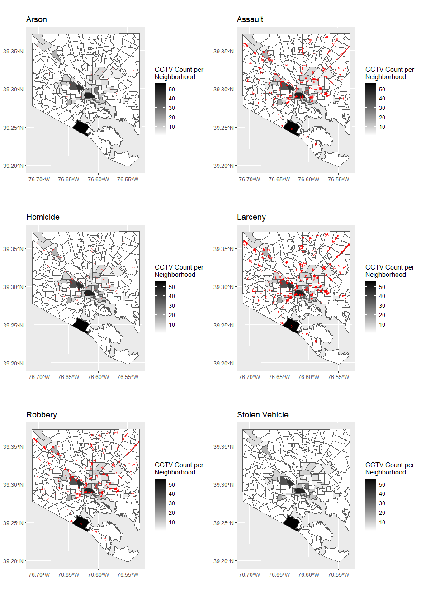
Same as Detroit, no clear pattern in terms of categories of crime, maybe something comes up if we add temporal factor.

Slide 8
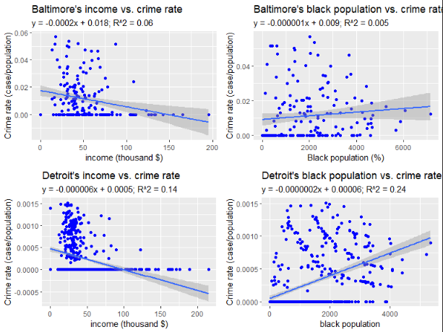
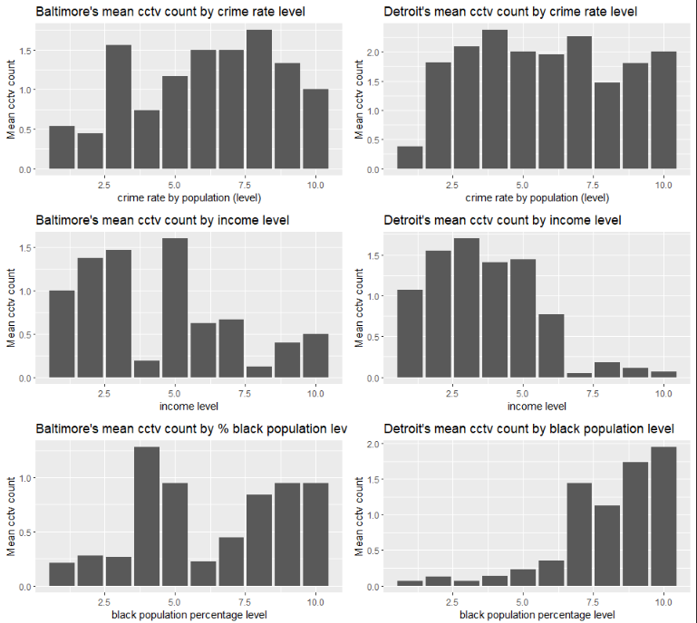
A
B
C
D
E
F
Correlations confirm intuition, more money = smaller crime rates. Black population density = higher crime rate. But the relationship is not statistically significant.
Each X-axis variable is divided in 10 categories in density (unsure how the team produced that number) but for instance, graph D shows that there is a higher presence of cctv in areas with a lower income (less 50% metric). Baltimore’s cctv relation to population and income variables don’t show clear tendencies.

Slide 9
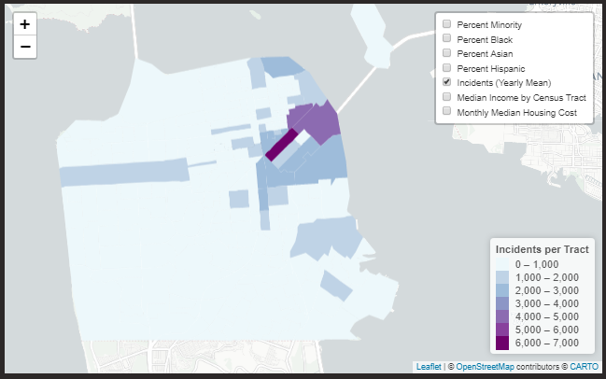
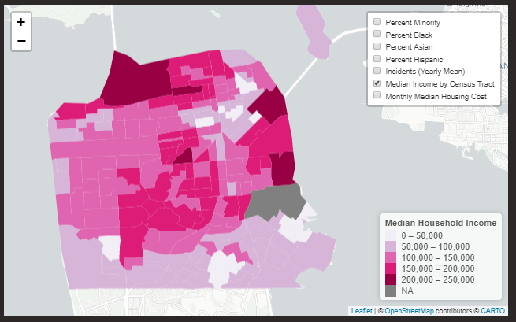
BUDGETFLOW (Anna, Robert, Ryan)
Interested in how and where there is demand for and distribution of policing resources and the urban landscape being policed. Incident data serves as a proxy for police activity, as it includes not only crime reports but other policing activities such as serving arrest warrants and other non-crime related police activity.
Where is the most police activity in relation to socio-demographics and land-use in different areas of the city. Where is police staffing proportionate with police activity?
Interactive map (can’t export, will show on Weds)

Slide 10
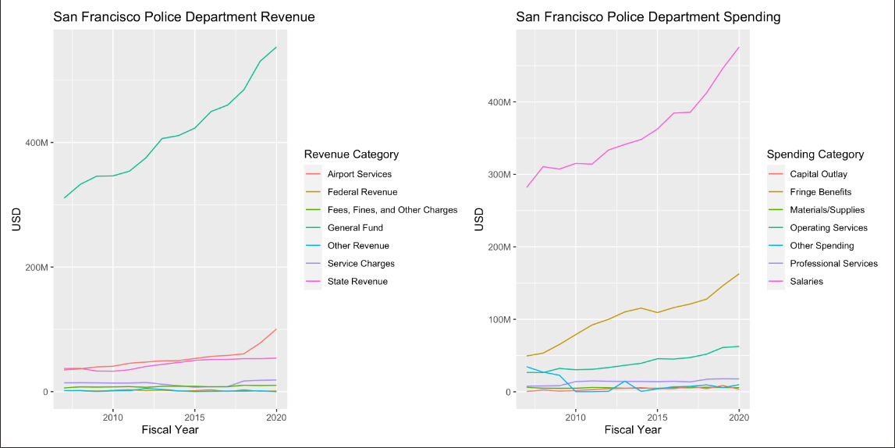

Slide 11
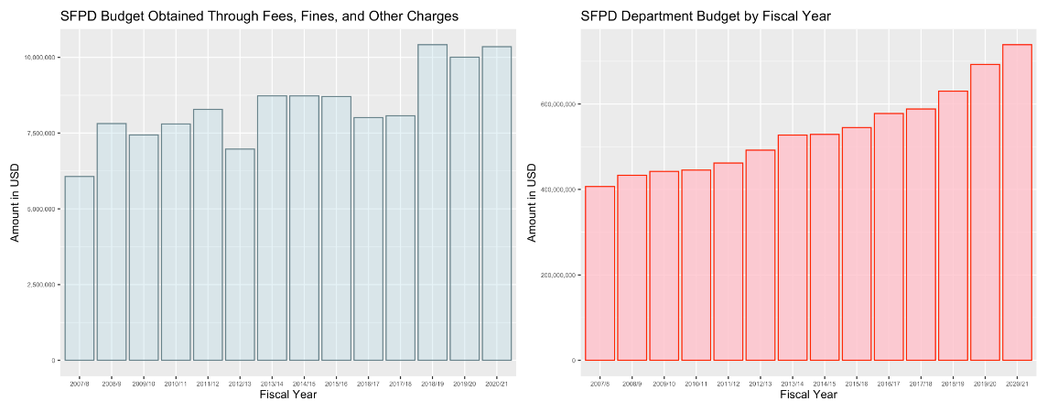
Would be easier do draw a proportional graph that show % of department budget made up by Fees, Fines, and Other charges.

Slide 12
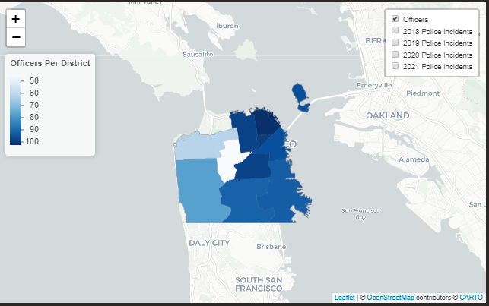
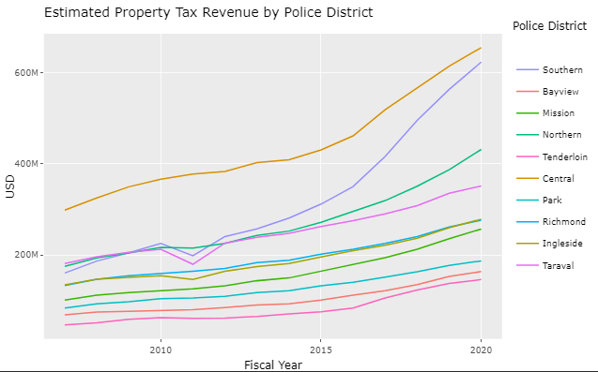
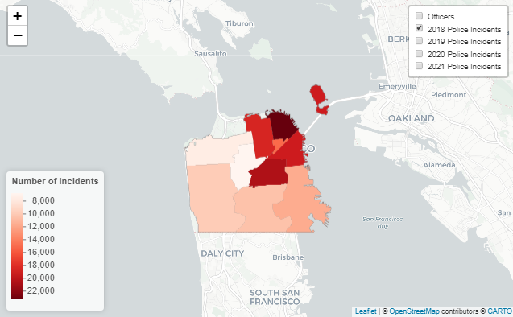

Slide 13
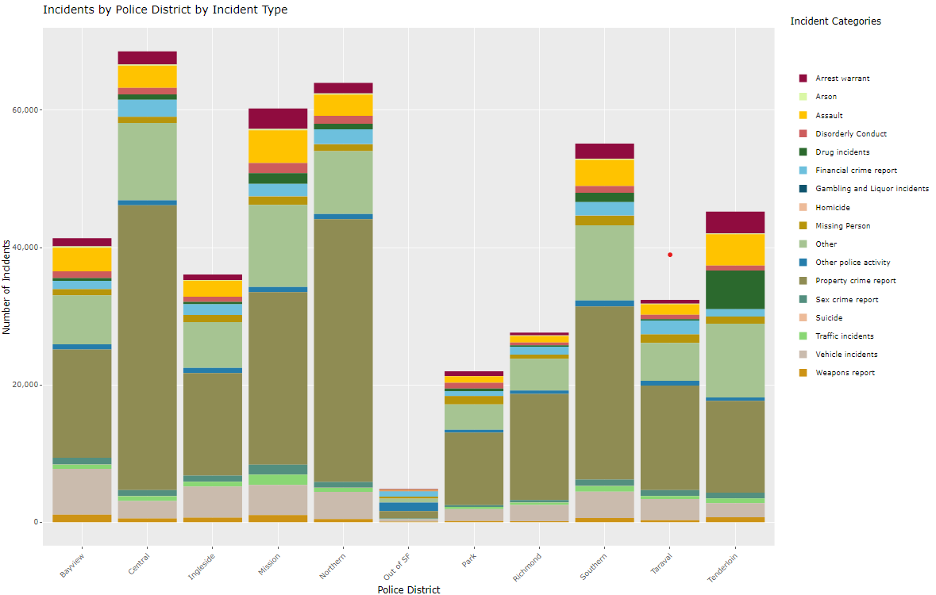

Slide 14
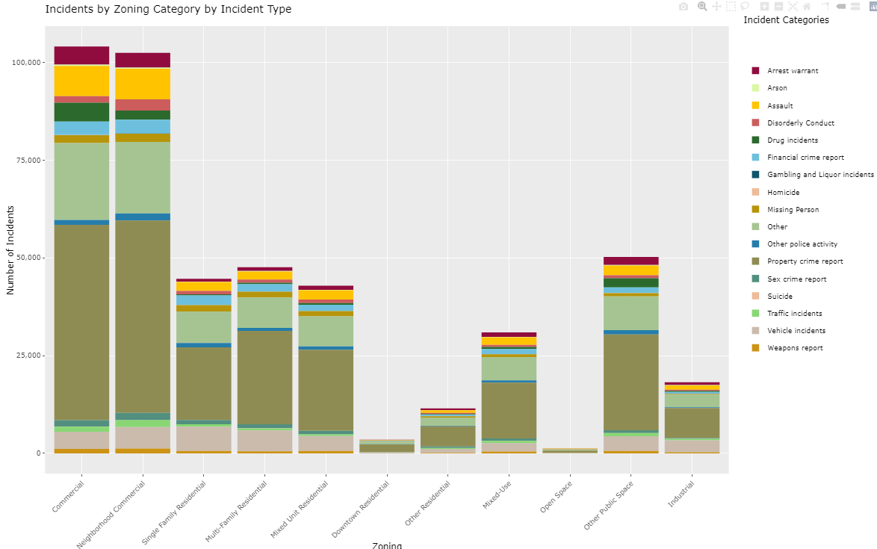

Slide 15
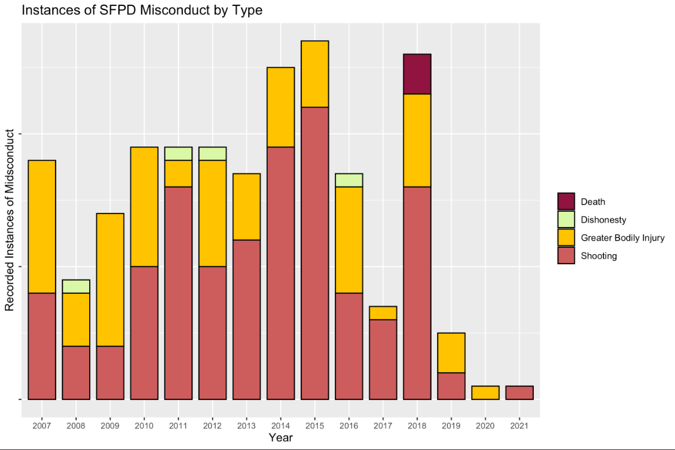
I wonder if we can plot these over police districts and see if there is a relationship between staffing, incidents, and property tax revenue trends.

Slide 16
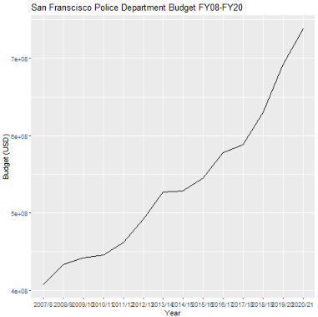
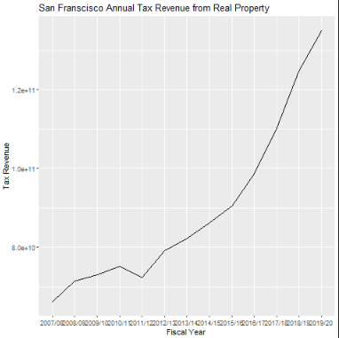
Policeprop (Julia, Atlas)
Interested in analyzing changes in property valuation and policing in San Francisco from 2007 to 2021. It compares spatial and temporal changes in property values with police budget changes.

Slide 17
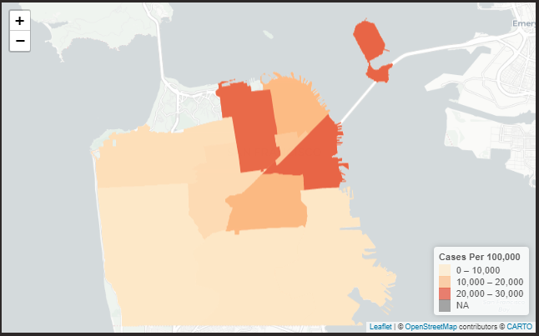
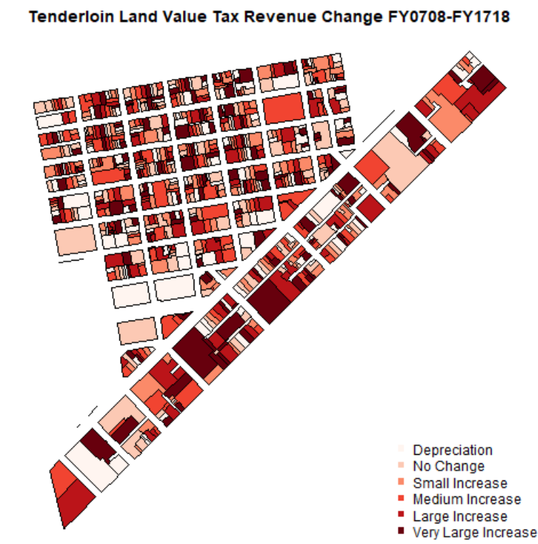
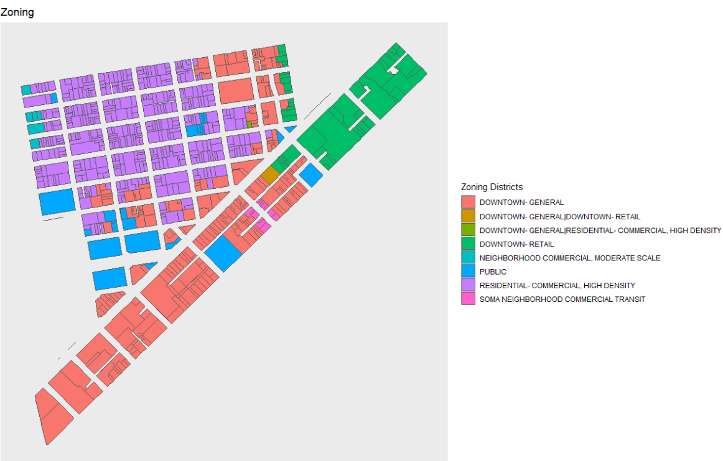
Neighborhood level analysis: Tenderloin district selected in this example because the Urban Displacement Project identifies the area as at a stage of "early or ongoing" gentrification - so example may show some dynamism. More info about the project on the website (https://www.urbandisplacement.org/maps/sf-bay-area-gentrification-and-displacement/)
It would be interesting to see this in an interactive map to get the actual numerical change. Further work, add socio-economic information. Add Land Use.

Slide 18
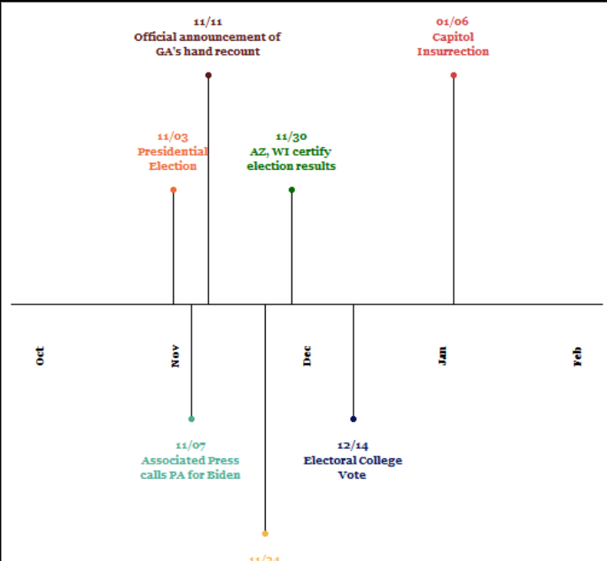
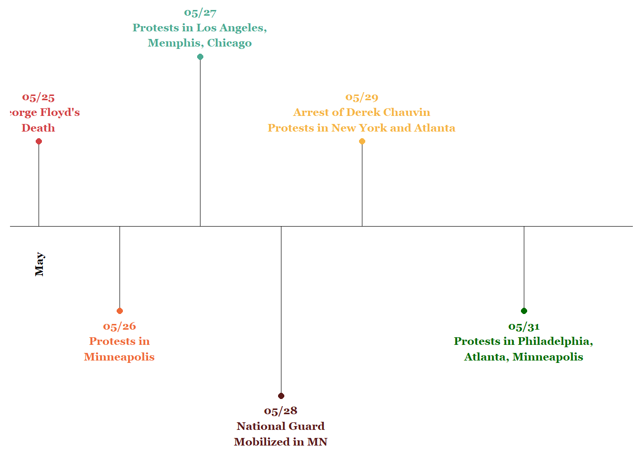
Hashtag sweep (Sadie, Valeria)
Examine the spatial dimensions of the role that Twitter played in the Black Lives Matter protests as well as the Capitol Insurrection.
Mapped the spatial distribution of the three most common hashtags for capitol insurrection (#stopthesteal, #voterfraud, #electionfraud) in key dates after the 2020 Presidential Election (November 3rd, 7th, 11th, 24th and 30th, December 14th, and January 6th
Mapped the spatial distribution of the Black Lives matter hashtags (using #blacklivesmatter, #blm, #icantbreathe, #georgefloyd) in key dates of the summer of 2020 (May 26th - 31st) and spring of 2021 (March 8th and 28th).

Slide 19
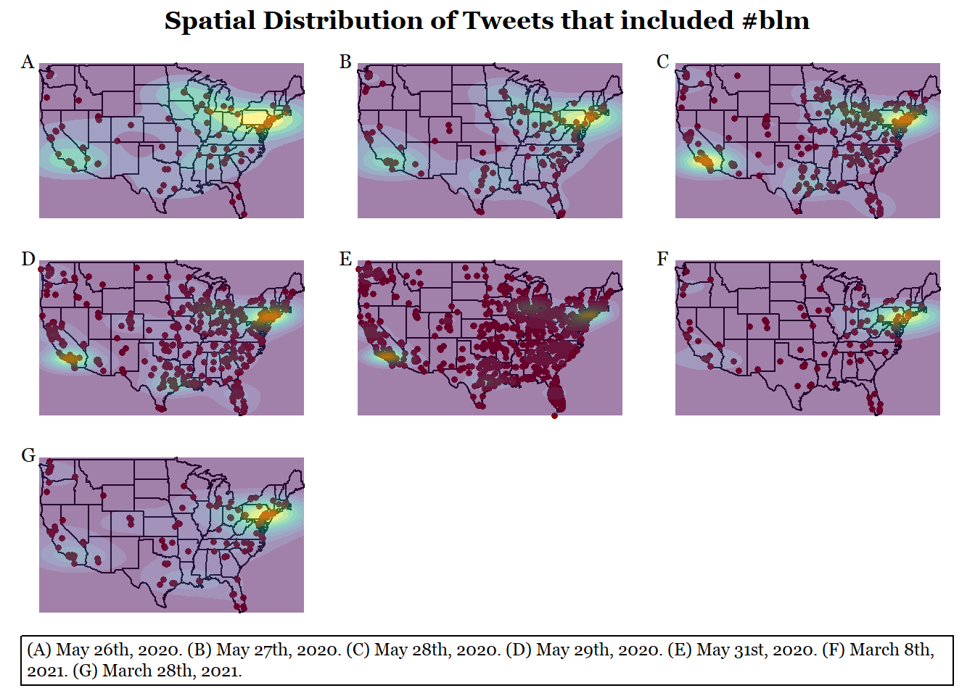
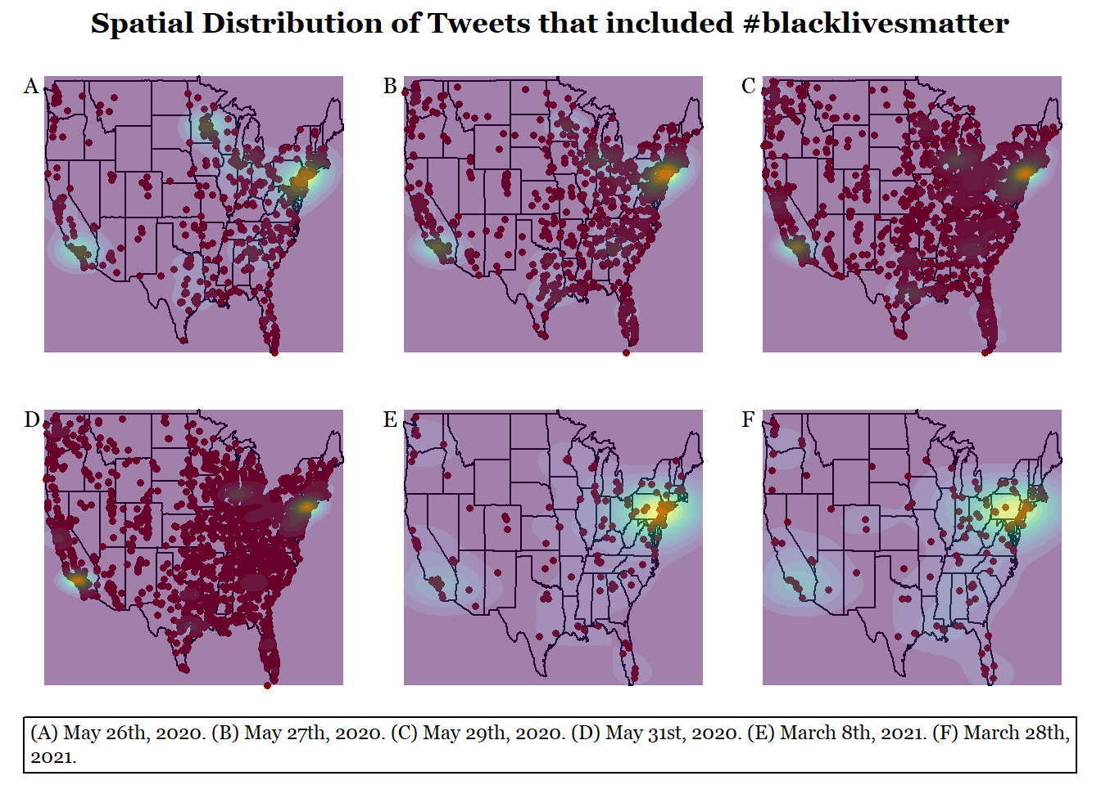
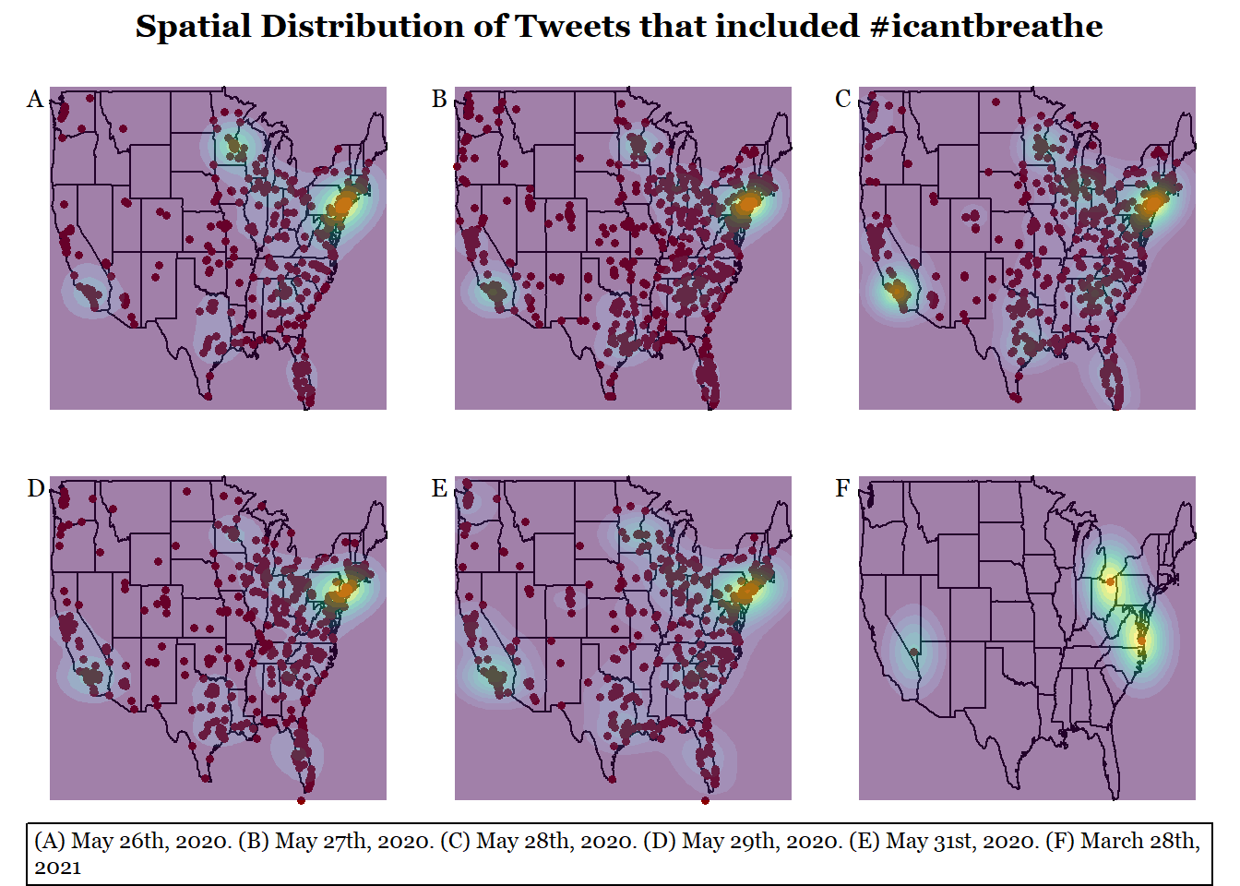
Limitations: this plots not where the tweet is from but where the user is from. Which is rather neat, explains the cluster/heatmaps of larger tweet density. Although California’s heatmap or lack thereof is interesting.

Slide 20
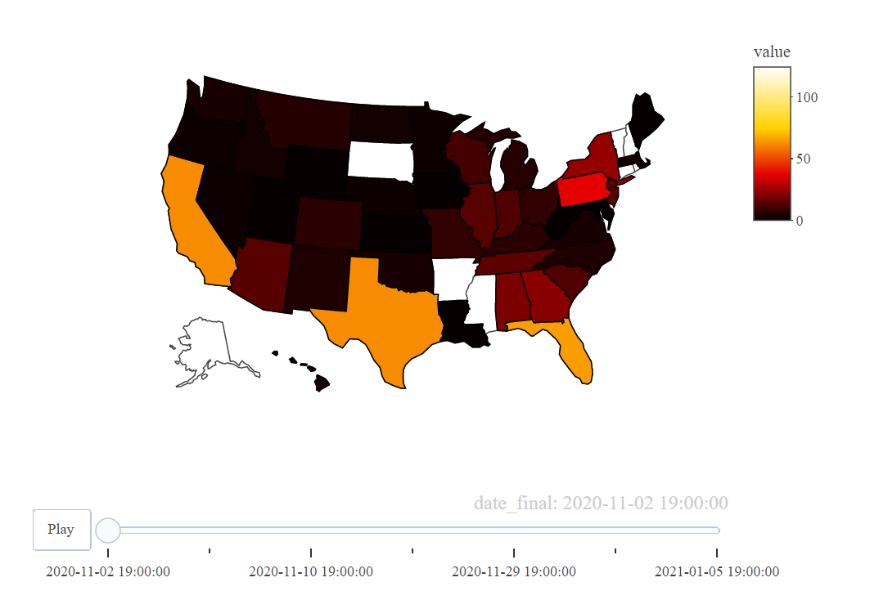
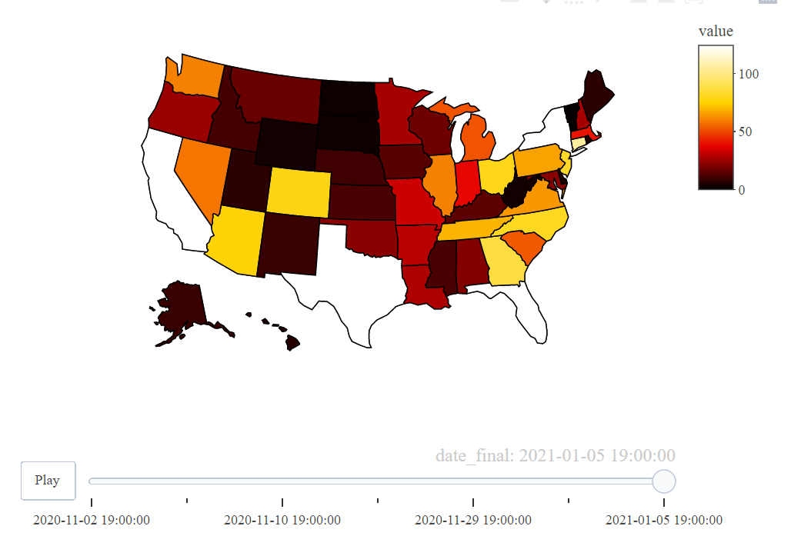
#stopthesteal
Day 1
Day 7

Slide 21
AAG workshop 2022
This workshop explores how the tools of geospatial analysis and data visualization can be used to analyze and work against contemporary practices of urban policing. Participants will identify the types of datasets and visualizations that help us to “see” the structures that enable state violence, with the goal being to inform subsequent development of open geospatial tools that promote more just urban futures. The workshop will utilize open source software (e.g. QGIS, R) for data analysis and visualization. Participants are welcome to suggest in advance and provide their own datasets for integration into the workshop.
Notes:
Notes on the workshop:
Playing with dough
- idea: send data before then, these are the types of tools we suggest you use, think about X/Y/Z questions
Prepare 2 sets: expertise in GIS stuff and non-GIS folks

